Slide 1
Module 6 – Linear Regression II

Slide 2
Model Selection
To evaluate the predictive accuracy of a linear regression, we can use metrics such as MAE, MSE, and RMSE.
To evaluate the model fit of a linear regression, we can use R-squared and adjusted R-squared.
AIC (Akaike’s Information Criteria), is a metric that penalizes the model by increasing the error when additional variables are added. The lower the AIC, the better the model.
BIC (Bayesian information criteria) is a variant of AIC with a stronger penalty for including additional variables to the model.

Slide 3
Feature Engineering
In general, feature engineering comes in two forms:
Converting non-numerical data into numerical ones:
Examples:
Creating categorical data into dummy variables
Text processing
Image processing
Creating new variables out of existing ones:
Examples:
Transforming data into a form more appropriate for a model (e.g. linear regression)
Combining features

Slide 4
Feature Engineering – Categorical Variables
One common type of non-numerical data is categorical data.
To use a non-numeric, or categorical variable, we have to transform the variable because we can't do math with non-numeric variables
Solution: Add binary (dummy) variables (one-hot encoding)
Suppose we have data on poverty in 50 U.S. states.
Location | Region | PovPct | ViolCrime | TeenBrth
Alabama | South | 20.1 | 11.2 | 54.5
Alaska | West | 7.1 | 9.1 | 39.5
Arizona | West | 16.1 | 10.4 | 61.2
Arkansas | East | 14.9 | 10.4 | 59.9
California | West | 16.7 | 11.2 | 41.1
Colorado | West | 8.8 | 5.8 | 47
Connecticut | East | 9.7 | 4.6 | 25.8
Delaware | East | 10.3 | 3.5 | 46.3

Slide 5
Feature Engineering – Categorical Variables
We want to predict the poverty % with 3 predictor variables: violent crime, teenage birth, and the region of the state.
A dummy variable has two values, generally 0 or 1.
You create one less dummy variable than the number of categories.
The category left out is represented by setting all dummies to 0.
e.g. If a variable is binary, add one dummy. If there are 4 categories, add 3 dummy variables.
e.g. Region has 3 categories -> Add 2 dummy variables
PovPct = β₀ + β₁ ViolCrime + β₂ TeenBrth + β₃ West + β₄ East
Each of the variables takes on a value of either 1 or 0. If the state is in the east, then the value for the east variable would be 1 while the other variables would be 0.

Slide 6
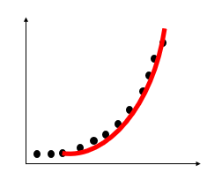
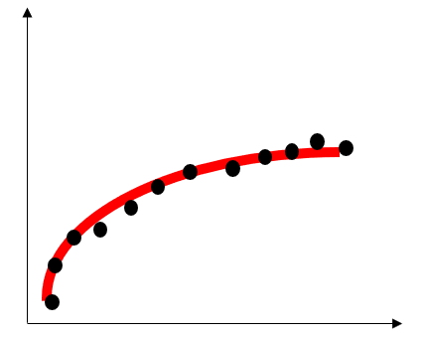
Feature Engineering – Derived Variables
A derived feature is mathematically derived from other input features
Transformations: When a variable’s transformation fits y variable better
y = β₀+ β₁ x²
y = β₀+ β₁ log(x)
Interactions:
If 2 variables have a joint impact on y variable
y = β₀+ β₁ x₁ + β₂ x₂ + β₃ x₁x₂
e.g. Poverty % = β ₀ + β₁ ViolCrime + β₂ TeenBrth + β₃ West + β₄ East + β₆ ViolCrime x West

Slide 7
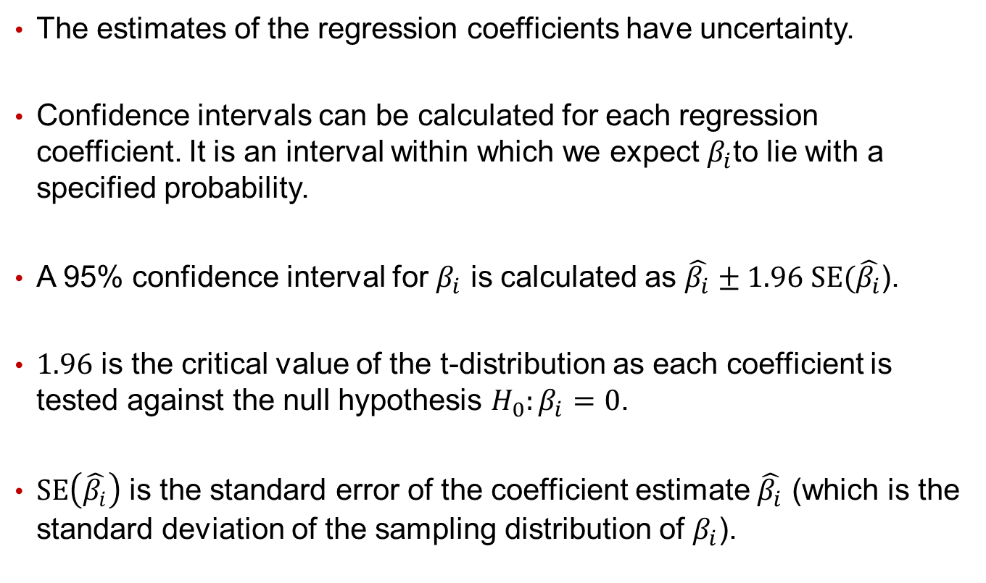
Confidence Interval of Regression Coefficients
The estimates of the regression coefficients have uncertainty.
Confidence intervals can be calculated for each regression coefficient. It is an interval within which we expect $β_{i}$to lie with a specified probability.
A 95% confidence interval for $β_{i}$ is calculated as $\hat{β_{i}}±1.96 SE(\hat{β_{i}}$).
$1.96$ is the critical value of the t-distribution as each coefficient is tested against the null hypothesis $H_{0}:β_{i}=0$.
$SE\left(\hat{β_{i}}\right)$ is the standard error of the coefficient estimate $\hat{β_{i}}$ (which is the standard deviation of the sampling distribution of $β_{i}$).

Slide 8
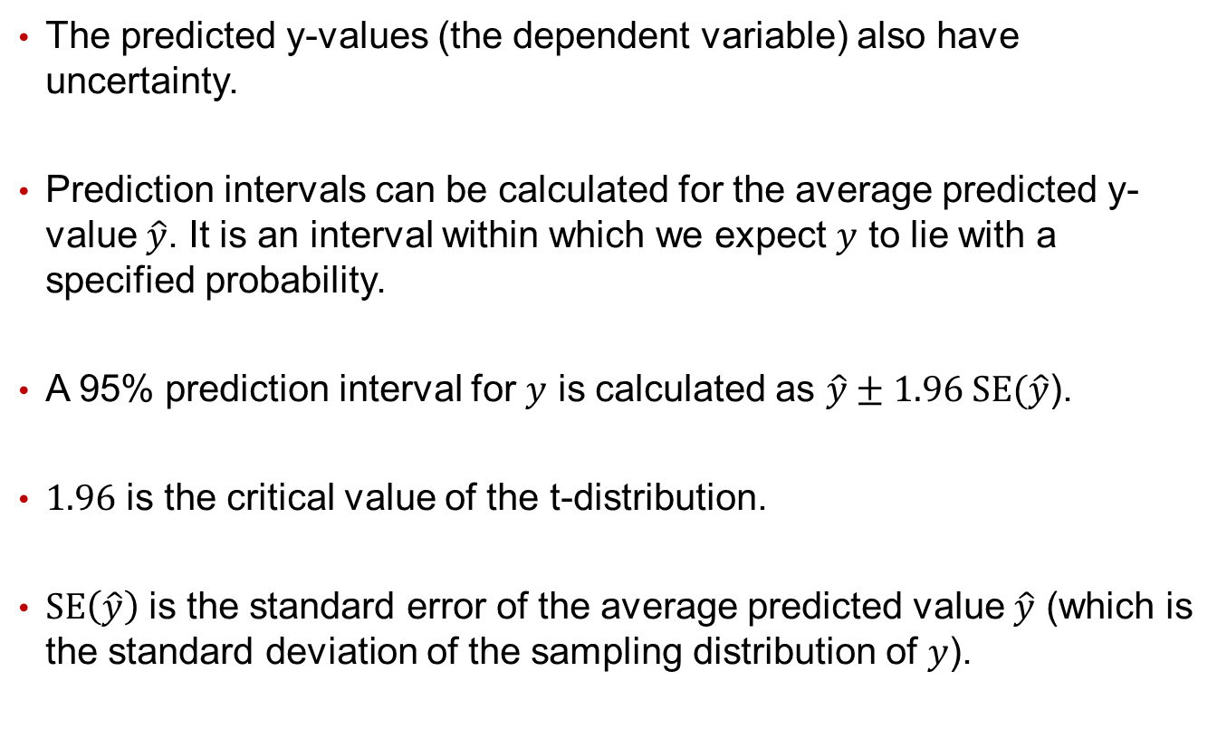
Prediction Interval of the Predicted Y-Value
The predicted y-values (the dependent variable) also have uncertainty.
Prediction intervals can be calculated for the average predicted y-value $\hat{y}$. It is an interval within which we expect $y$ to lie with a specified probability.
A 95% prediction interval for $y$ is calculated as $\hat{y}±1.96 SE(\hat{y}$).
$1.96$ is the critical value of the t-distribution.
$SE\left(\hat{y}\right)$ is the standard error of the average predicted value $\hat{y}$ (which is the standard deviation of the sampling distribution of $y$).

